Slide 1
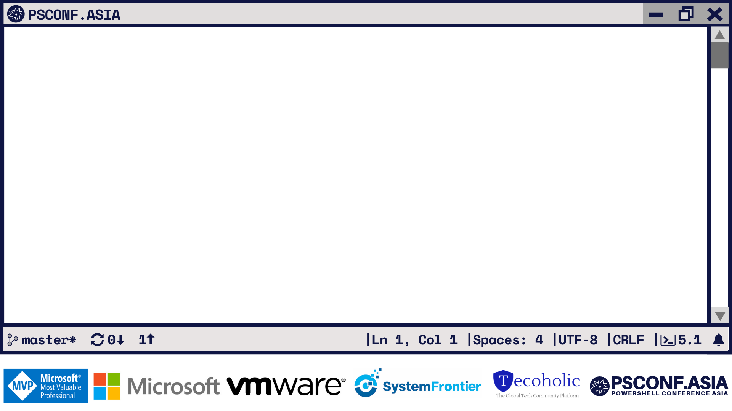
PowerShell Modules
From Manifest to Memory
Rob Holt Software Engineer, PowerShell Team
LF
7.0

Slide 2
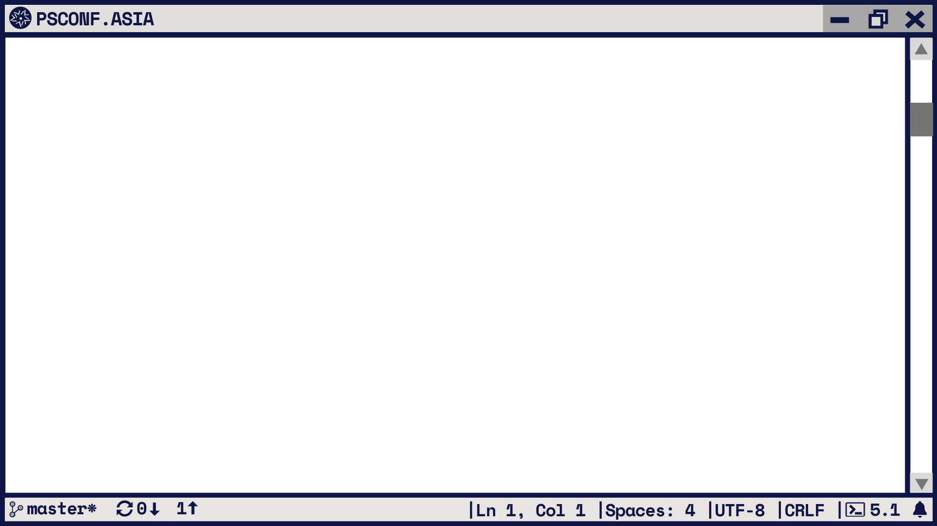
Modules? What are those?
Reusable, contained unit of functionality
Install, load, use, unload, uninstall
Usually cohesive around some feature or domain
The PowerShell API/SDK for…
Provides commands, but also types, formatters, providers, …
Core piece of PowerShell functionality
Almost all PowerShell cmdlets come from modules
Designed to be largely invisible
“the thing about an operating system is that you're never ever supposed to see it”
LF
7.0

Slide 3
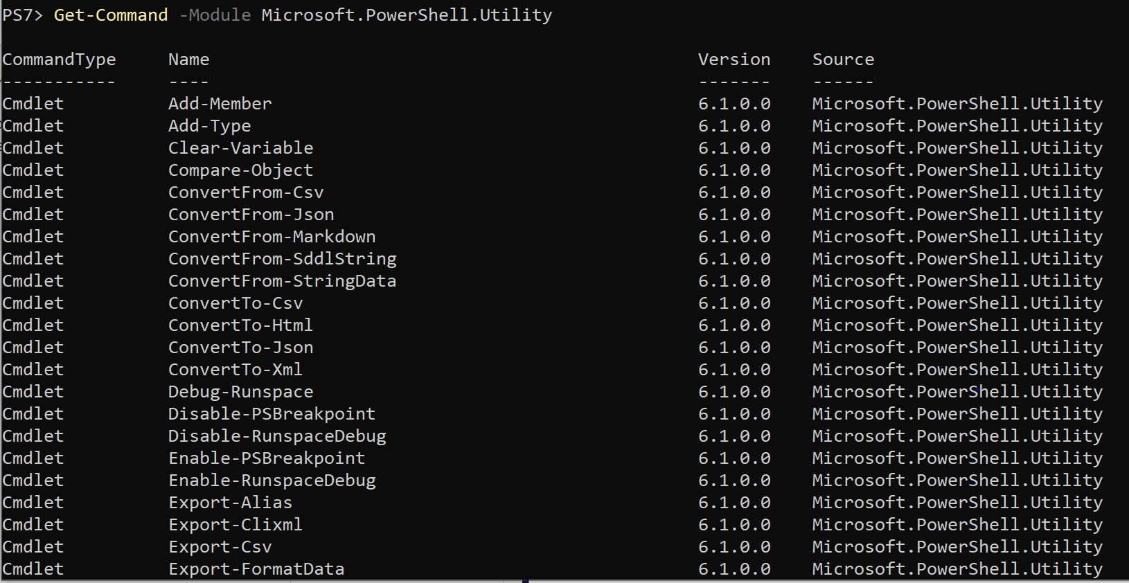
Modules? What are those?
LF
7.0

Slide 4
Why should PowerShell have modules?
CMD and bash don’t need modules – why does PowerShell?
Native utils 1-1 with files, but cmdlets come from DLLs
DLLs are hard for humans to read, so build a system around them
Want to make PowerShell a first-class citizen
Dot-sourcing a ps1 doesn’t quite cut it
Everything exported, but don’t know what ahead of time
Want to delineate imperative from declarative
(The real reason: because Perl has modules)
LF
7.0
Notes:
Dot-sourcing doesn’t distinguish internal implementation from external interface
Psm1 is a signal for a declarative approach; what functions it exports is the important part, not the how

Slide 5
The module (digestive) system
ExecutionContext
ModuleIntrinsics
ScriptAnalysis/
AnalysisCache
SessionStateInternal
PSModuleInfo
ModuleCmdletBase
Get-Module
Remove-Module
Import-Module
New-Module
Test-ModuleManifest
LF
7.0
Notes:
Get/Import/Remove are main interfaces for module manipulation
Other cmdlets also work with modules, but we won’t look at those
All use ModuleCmdletBase, inherit from it, most code in there
All work around PSModuleInfo, the data structure representing a module
ScriptAnalysis is for analysing modules without running or loading them
ModuleInstrinsics deals with loading and tracking modules
ExecutionContext and SessionStateInternal represent the greater PowerShell context and are effectively what modules are being loaded into
But ModuleCmdletBase is where all the fun happens and most of what we’ll be looking at

Slide 6
Module discovery
In order to use a module, we must find it
Can specify the easy way, by path: C:\right\here\MyModule.psm1
But: C:\right\here\MyModule
Or the hard way, by name: Import-Module MyModule
This means searching the PSModulePath
LF
7.0
Notes:
To use a module in any way, we have to go from specifying it to finding the actual code
Specifying a module by path is relatively straightforward
But modules can be pointed at by directory, which still requires some searching
More commonly, we load by name
This means not only loading from a directory, but first finding that directory on the PSModulePath

Slide 7
The PSModulePath
List of directories to find modules in, like $env:PATH
Why not reuse $env:PATH?
Don’t want to load every DLL/EXE on the $env:PATH
Changing $env:PATH for PowerShell modules could affect CMD, etc
An environment variable that doesn’t play by the rules
If you set it, do it in your $PROFILE or config (Registry/config.json)
Three (or four) parts by default, in order:
User path (~\Documents\PowerShell\Modules)
Shared path ($env:ProgramFiles\PowerShell\Modules)
Installation path ($PSHOME\Modules)
(In PowerShell 6+ on Windows) Windows PowerShell installation path
LF
7.0

Slide 8
How modules are structured
Module
SubModule2
Module.psm1
Module.psd1
Module.dll
SubModule1.psm1
Types.ps1xml
OnImport.ps1
LF
7.0

Slide 9
Searching the PSModulePath
Import-Module MyModule
PSModulePath: “C:\first;C:\second;C:\third”
LF
7.0

Slide 10
Searching the PSModulePath
Import-Module MyModule
PSModulePath: “C:\first;C:\second;C:\third”
C:\third\
C:\second\
C:\first\
MyModule\
LF
7.0
Notes:
First look for the module directory
In this case, it’s not there so move on

Slide 11
Searching the PSModulePath
Import-Module MyModule
PSModulePath: “C:\first;C:\second;C:\third”
C:\third\
C:\second\
C:\first\
MyModule\
LF
7.0
Notes:
Find the module directory

Slide 12
Searching the PSModulePath
Import-Module MyModule
PSModulePath: “C:\first;C:\second;C:\third”
C:\third\
C:\second\
C:\first\
MyModule\
X.Y.Z\
LF
7.0
Notes:
Look for versioned directory; SxS module versions since 5.0
Not found, so begin extension search

Slide 13
Searching the PSModulePath
Import-Module MyModule
PSModulePath: “C:\first;C:\second;C:\third”
C:\third\
C:\second\
C:\first\
MyModule\
MyModule.psd1
MyModule.psm1 MyModule.cdxml
MyModule.ni.dll
MyModule.dll MyModule.exe
LF
7.0
Notes:
Begin with psd1, since finding that will set the rest of the whole module’s structure
Otherwise, proceed in a standard list
Note we never look for a ps1 file
While these can be imported as modules, they don’t work well as structured modules

Slide 14
Searching the PSModulePath
Import-Module MyModule
PSModulePath: “C:\first;C:\second;C:\third”
C:\third\
C:\second\
C:\first\
MyModule.psd1
MyModule.psm1 MyModule.cdxml
MyModule.ni.dll
MyModule.dll MyModule.exe
MyModule\
LF
7.0

Slide 15
Searching the PSModulePath
Import-Module MyModule
PSModulePath: “C:\first;C:\second;C:\third”
MyModule.psd1
MyModule.psm1 MyModule.cdxml
MyModule.ni.dll
MyModule.dll MyModule.exe
C:\third\
C:\second\
C:\first\
MyModule\
LF
7.0
Notes:
Begin with psd1, since finding that will set the rest of the whole module’s structure
Otherwise, proceed in a standard list
Note we never look for a ps1 file
While these can be imported as modules, they don’t work well as structured modules

Slide 16
Searching the PSModulePath
Import-Module MyModule
PSModulePath: “C:\first;C:\second;C:\third”
MyModule.psd1
MyModule.psm1 MyModule.cdxml
MyModule.ni.dll
MyModule.dll MyModule.exe
C:\third\
C:\second\
C:\first\
MyModule\
LF
7.0
Notes:
Ni.dll means a DLL that has been compiled to native code to make it faster
This is sometimes generated from a DLL on first run by .NET
We look for this first, since it will be a faster version of the DLL

Slide 17
Searching the PSModulePath
Import-Module MyModule
MyModule.psd1
MyModule.psm1 MyModule.cdxml
MyModule.ni.dll
MyModule.dll MyModule.exe
PSModulePath: “C:\first;C:\second;C:\third”
C:\third\
C:\second\
C:\first\
MyModule\
LF
7.0
Notes:
Ni.dll means a DLL that has been compiled to native code to make it faster
This is sometimes generated from a DLL on first run by .NET
We look for this first, since it will be a faster version of the DLL

Slide 18
Searching the PSModulePath
Import-Module MyModule
MyModule.psd1
MyModule.psm1 MyModule.cdxml
MyModule.ni.dll
MyModule.dll MyModule.exe
PSModulePath: “C:\first;C:\second;C:\third”
C:\third\
C:\second\
C:\first\
MyModule\
LF
7.0
Notes:
Since PS 6, EXEs can be loaded as module
Naturally we look for this last since (1) all other file types should be preferred and (2) this was added most recently, so putting it first would break existing things

Slide 19
Searching the PSModulePath
Import-Module MyModule
PSModulePath: “C:\first;C:\second;C:\third”
C:\third\
C:\second\
C:\first\
MyModule\
LF
7.0
Notes:
Since PS 6, EXEs can be loaded as module
Naturally we look for this last since (1) all other file types should be preferred and (2) this was added most recently, so putting it first would break existing things

Slide 20
Searching the PSModulePath
Import-Module MyModule
PSModulePath: “C:\first;C:\second;C:\third”
MyModule\
C:\third\
C:\second\
C:\first\
X.Y.Z
LF
7.0
Notes:
Since PS 6, EXEs can be loaded as module
Naturally we look for this last since (1) all other file types should be preferred and (2) this was added most recently, so putting it first would break existing things

Slide 21
Searching the PSModulePath
Import-Module MyModule
PSModulePath: “C:\first;C:\second;C:\third”
MyModule\
C:\third\
C:\second\
C:\first\
MyModule.psd1
MyModule.psm1 MyModule.cdxml
MyModule.ni.dll
MyModule.dll MyModule.exe
LF
7.0
Notes:
Since PS 6, EXEs can be loaded as module
Naturally we look for this last since (1) all other file types should be preferred and (2) this was added most recently, so putting it first would break existing things

Slide 22
Searching the PSModulePath
Import-Module MyModule
PSModulePath: “C:\first;C:\second;C:\third”
MyModule\
C:\third\
C:\second\
C:\first\
MyModule.psd1
MyModule.psm1 MyModule.cdxml
MyModule.ni.dll
MyModule.dll MyModule.exe
LF
7.0
Notes:
Since PS 6, EXEs can be loaded as module
Naturally we look for this last since (1) all other file types should be preferred and (2) this was added most recently, so putting it first would break existing things

Slide 23
Searching the PSModulePath
MyModule\
C:\third\
C:\second\
C:\first\
MyModule.psd1
MyModule.psm1 MyModule.cdxml
MyModule.ni.dll
MyModule.dll MyModule.exe
Import-Module MyModule
LF
7.0
Notes:
Since PS 6, EXEs can be loaded as module
Naturally we look for this last since (1) all other file types should be preferred and (2) this was added most recently, so putting it first would break existing things

Slide 24
Searching the PSModulePath
MyModule\
C:\third\
C:\second\
C:\first\
MyModule.psd1
MyModule.psm1 MyModule.cdxml
MyModule.ni.dll
MyModule.dll MyModule.exe
Import-Module mymodule
Note: Although paths on *nix are case-sensitive, this search for the module by name is not. `mymodule` will match `MyModule/MyModule.psd1` on macOS.
LF
7.0
Notes:
Since PS 6, EXEs can be loaded as module
Naturally we look for this last since (1) all other file types should be preferred and (2) this was added most recently, so putting it first would break existing things

Slide 25
Loading a module
Determine the module type from the extension
Process some parts in an InitialSessionState (template for a SS)
Load it into a fresh scope in SessionState
Put all the relevant parts in a PSModuleInfo object
Flush the exports into the calling SessionState (your session)
Add the module to the module table
LF
7.0
Notes:
A session state is like a context or big scope
An initial session state is like the precursor to a session state, a template for one
Modules are loaded into a session state
But each module contains its own session state

Slide 26
The PSModuleInfo object
Beating heart of a module
Can represent a loaded module, or be a thin manifest wrapper
Import-Module -PassThru vs Get-Module –ListAvailable
Tracks all the exports of a module + metadata
Publicly looks like the manifest
Internally keeps track of module scope and state
Some settable properties (e.g. AccessMode, OnRemove)
LF
7.0

Slide 27
Loading binary (DLL) modules
Module
Intrinsics
Add to
module table
Current
SessionState
InitialSessionState
[Alias]
Aliases
Cmdlets
Aliases
Cmdlets
Bind()
(Load)
[Cmdlet]
PSModuleInfo
IModuleAssemblyInitializer
.OnImport()
[Provider]
Assembly.Load()
Providers
Providers
Module
Assembly
Module.dll
LF
7.0

Slide 28
Loading script (PSM1) modules
Module
Intrinsics
Current
SessionState
Functions
Add to
module table
Cmdlets
Fresh
SessionState
Classes
Variables
Aliases
Classes compiled to dynamic assemblies and scoped
Dot-source
Import members
Export-ModuleMember
(or implicitly everything)
PSModuleInfo
Module.psm1
LF
7.0
Notes:
Classes compiled to dynamic assembly that is scoped to the current module
This happens before other exports

Slide 29
Loading a PS1
Module
Intrinsics
Current
SessionState
Classes
Functions
Add to
module table
Cmdlets
Variables
Aliases
PSModuleInfo
Dot-source
Create dummy
Module.ps1
LF
7.0

Slide 30
Loading CDXML modules
Current
SessionState
Not common in user modules
Usually from modules shipped in Windows
An XML format to declaratively specify cmdlets and objects
Wrap WMI/CIM calls
ScriptWriter
(CDXML to PS converter)
Module_cdxml.psm1
Load as normal PSM1
Module.cdxml
LF
7.0

Slide 31
The module manifest
$manifest = @{
Author = …; Copyright = …; … # Pure metadata
CmdletsToExport = @(…); … # Exports
TypesToProcess = @(…); … # Process on load
PowerShellVersion = …; … # Platform constraints
PrivateData = @{ PSData = @{ … } } # PSGet, SemVer2
RootModule = …; NestedModules = … # Recursive structure
CompatiblePSEditions = @(‘Core’, ‘Desktop’)
}
LF
7.0

Slide 32
Loading manifest (PSD1) modules
Module.psd1
LF
7.0

Slide 33
Loading manifest (PSD1) modules
Manifest
Hashtable
Load as ScriptBlock,
Execute in
RestrictedLanguage mode
Module.psd1
LF
7.0

Slide 34
Loading manifest (PSD1) modules
PSModuleInfo
Manifest
Hashtable
Author
Description
Company
GUID
ModuleName
ModuleList
Version
FileList
HelpInfoURI
Copyright
Create a new empty PSModuleInfo and copy over pure metadata fields
LF
7.0

Slide 35
Loading manifest (PSD1) modules
Version
ModuleName
Description
PSModuleInfo
GUID
Company
Manifest
Hashtable
Copyright
Author
FileList
Create a new empty PSModuleInfo and copy over pure metadata fields
ModuleList
HelpInfoURI
LF
7.0

Slide 36
Loading manifest (PSD1) modules
PSModuleInfo
GUID
FileList
Company
ModuleList
Description
Version
HelpInfoURI
Author
ModuleName
Copyright
Manifest
Hashtable
Create a new empty PSModuleInfo and copy over pure metadata fields
LF
7.0

Slide 37
Loading manifest (PSD1) modules
PSModuleInfo
Manifest
Hashtable
PrivateData
Copy PrivateData, read PrivateData.PSData
LF
7.0

Slide 38
Loading manifest (PSD1) modules
PSModuleInfo
PSData
PowerShellGet
Manifest
Hashtable
Version preview tags
Experimental features
Copy PrivateData, read PrivateData.PSData
LF
7.0

Slide 39
Loading manifest (PSD1) modules
PSModuleInfo
Manifest
Hashtable
ProcessorArchitecture
PowerShellHostVersion
PowerShellVersion
CLRVersion
PowerShellHostName
DotNetFrameworkVersion
Read and test module import constraints
LF
7.0

Slide 40
Loading manifest (PSD1) modules
ProcessorArchitecture
PowerShellVersion
PSModuleInfo
PowerShellHostName
Manifest
Hashtable
PowerShellHostVersion
DotNetFrameworkVersion
CLRVersion
Read and test module import constraints
LF
7.0

Slide 41
Loading manifest (PSD1) modules
ProcessorArchitecture
PowerShellVersion
PSModuleInfo
PowerShellHostName
Manifest
Hashtable
PowerShellHostVersion
DotNetFrameworkVersion
CLRVersion
Read and test module import constraints
LF
7.0

Slide 42
Loading manifest (PSD1) modules
PSModuleInfo
Manifest
Hashtable
ProcessorArchitecture
PowerShellVersion
PowerShellHostName
DotNetFrameworkVersion
PowerShellHostVersion
CLRVersion
Read and test module import constraints
LF
7.0

Slide 43
Loading manifest (PSD1) modules
PSModuleInfo
Manifest
Hashtable
ProcessorArchitecture
PowerShellVersion
PowerShellHostName
DotNetFrameworkVersion
CompatiblePSEditions
PowerShellHostVersion
CLRVersion
Copy CompatiblePSEditions. If loading from Windows Powershell module in PS 6+, check compatibility.
LF
7.0

Slide 44
Loading manifest (PSD1) modules
PSModuleInfo
Manifest
Hashtable
ProcessorArchitecture
PowerShellVersion
PowerShellHostName
DotNetFrameworkVersion
CompatiblePSEditions
PowerShellHostVersion
CLRVersion
Copy CompatiblePSEditions. If loading from Windows Powershell module in PS 6+, check compatibility.
LF
7.0

Slide 45
Loading manifest (PSD1) modules
PSModuleInfo
Manifest
Hashtable
Read and test module import constraints
LF
7.0

Slide 46
Loading manifest (PSD1) modules
PSModuleInfo
Manifest
Hashtable
FunctionsToExport
CmdletsToExport
VariablesToExport
AliasesToExport
Read export lists
(but don’t “export” yet)
LF
7.0

Slide 47
Loading manifest (PSD1) modules
CmdletsToExport
AliasesToExport
PSModuleInfo
Manifest
Hashtable
VariablesToExport
FunctionsToExport
Read export lists
(but don’t “export” yet)
LF
7.0

Slide 48
Loading manifest (PSD1) modules
PSModuleInfo
Manifest
Hashtable
VariablesToExport
AliasesToExport
CmdletsToExport
FunctionsToExport
Read export lists
(but don’t “export” yet)
LF
7.0

Slide 49
Loading manifest (PSD1) modules
PSModuleInfo
Manifest
Hashtable
RequiredModules
Load any RequiredModules into the loading session
LF
7.0

Slide 50
Loading manifest (PSD1) modules
PSModuleInfo
Manifest
Hashtable
RequiredModules
Current
SessionState
Load any RequiredModules into the loading session
LF
7.0

Slide 51
Loading manifest (PSD1) modules
PSModuleInfo
Manifest
Hashtable
RequiredModules
Current
SessionState
Load any RequiredModules into the loading session
LF
7.0

Slide 52
Loading manifest (PSD1) modules
PSModuleInfo
Manifest
Hashtable
Load fields that need preprocessing into a new InitialSessionState

Slide 53
Loading manifest (PSD1) modules
PSModuleInfo
Manifest
Hashtable
RequiredAssemblies
TypesToProcess
FormatsToProcess
Load fields that need preprocessing into a new InitialSessionState
LF
7.0

Slide 54
Loading manifest (PSD1) modules
RequiredAssemblies
PSModuleInfo
Manifest
Hashtable
TypesToProcess
Load fields that need preprocessing into a new InitialSessionState
FormatsToProcess
LF
7.0

Slide 55
Loading manifest (PSD1) modules
RequiredAssemblies
Initial
SessionState
PSModuleInfo
Manifest
Hashtable
TypesToProcess
Load fields that need preprocessing into a new InitialSessionState
FormatsToProcess
LF
7.0

Slide 56
Loading manifest (PSD1) modules
Initial
SessionState
PSModuleInfo
Manifest
Hashtable
RequiredAssemblies
FormatsToProcess
TypesToProcess
Load fields that need preprocessing into a new InitialSessionState
LF
7.0

Slide 57
Loading manifest (PSD1) modules
Initial
SessionState
PSModuleInfo
Manifest
Hashtable
Load fields that need preprocessing into a new InitialSessionState
LF
7.0

Slide 58
Loading manifest (PSD1) modules
Fresh
SessionState
Initial
SessionState
PSModuleInfo
Bind()
Manifest
Hashtable
Load assemblies, types and formats into new SS
LF
7.0

Slide 59
Loading manifest (PSD1) modules
Fresh
SessionState
PSModuleInfo
Bind()
Manifest
Hashtable
Load assemblies, types and formats into new SS
LF
7.0

Slide 60
Loading manifest (PSD1) modules
Fresh
SessionState
PSModuleInfo
Manifest
Hashtable
Run any scripts to process
LF
7.0

Slide 61
Loading manifest (PSD1) modules
Fresh
SessionState
PSModuleInfo
Manifest
Hashtable
ScriptsToProcess
Run any scripts to process
LF
7.0

Slide 62
Loading manifest (PSD1) modules
Fresh
SessionState
PSModuleInfo
Manifest
Hashtable
Load NestedModules into module scope
LF
7.0

Slide 63
Loading manifest (PSD1) modules
Fresh
SessionState
PSModuleInfo
NestedModules
Manifest
Hashtable
Load NestedModules into module scope
LF
7.0

Slide 64
Loading manifest (PSD1) modules
Fresh
SessionState
PSModuleInfo
NestedModules
Manifest
Hashtable
Load NestedModules into module scope
LF
7.0

Slide 65
Loading manifest (PSD1) modules
Fresh
SessionState
PSModuleInfo
Manifest
Hashtable
RootModule
Finally, process the RootModule
LF
7.0

Slide 66
Loading manifest (PSD1) modules
Fresh
SessionState
PSModuleInfo
Manifest
Hashtable
RootModule
Finally, process the RootModule if there is one
LF
7.0

Slide 67
Loading manifest (PSD1) modules
Fresh
SessionState
PSModuleInfo
ModuleType
Manifest
Hashtable
RootModule
Reassign metadata properties from the RootModule
Path
LF
7.0

Slide 68
Loading manifest (PSD1) modules
Fresh
SessionState
PSModuleInfo
ModuleType
Path
Manifest
Hashtable
RootModule
Reassign metadata properties from the RootModule
LF
7.0

Slide 69
Loading manifest (PSD1) modules
Fresh
SessionState
PSModuleInfo
Manifest
Hashtable
RootModule
Reassign metadata properties from the RootModule
LF
7.0

Slide 70
Loading manifest (PSD1) modules
PSModuleInfo
Wrap the module session state in the PSModuleInfo
Fresh
SessionState
LF
7.0

Slide 71
Loading manifest (PSD1) modules
PSModuleInfo
Export the members of the wrapped session state through the export filter
Fresh
SessionState
LF
7.0

Slide 72
Loading manifest (PSD1) modules
PSModuleInfo
Export the members of the wrapped session state through the export filter
Fresh
SessionState
Variables
Functions
Cmdlets
Aliases
LF
7.0

Slide 73
Loading manifest (PSD1) modules
Functions
PSModuleInfo
Cmdlets
Export the members of the wrapped session state through the export filter
Fresh
SessionState
Variables
Aliases
LF
7.0

Slide 74
Loading manifest (PSD1) modules
Functions
PSModuleInfo
Cmdlets
Export the members of the wrapped session state through the export filter
Fresh
SessionState
Variables
Aliases
LF
7.0

Slide 75
Loading manifest (PSD1) modules
Functions
Functions
Cmdlets
PSModuleInfo
Cmdlets
Load the exported members into the executing session state
Fresh
SessionState
Module
Intrinsics
Current
SessionState
Add PSModuleInfo to module table
Variables
Aliases
Variables
Aliases
LF
7.0

Slide 76
Module scope
The session state modules come with is a “scope”
Functions, classes, $script: variables all live in this
Resolving definitions looks to these first
Can invoke within module scope: & (gmo <module>) { … }
LF
7.0

Slide 77
Module scope
function Test-Inner { ‘AAA’ }
function Test-Outer { Test-Inner }
Test-Outer # ‘AAA’
& { function Test-Inner { ‘BBB’ }; Test-Outer } # ‘BBB’
# Due to PowerShell’s dynamic scope
LF
7.0

Slide 78
Module scope
<calling scope>
Test-Inner
function Test-Inner { ‘AAA’ }
function Test-Outer { Test-Inner }
Test-Outer # ‘AAA’
& { function Test-Inner { ‘BBB’ }; Test-Outer } # ‘BBB’
# Due to PowerShell’s dynamic scope
# BUT!
Test-Outer
Test-Inner
Test-Outer
LF
7.0

Slide 79
Module scope
<calling scope>
Test-Inner
function Test-Inner { ‘AAA’ }
function Test-Outer { Test-Inner }
Test-Outer # ‘AAA’
& { function Test-Inner { ‘BBB’ }; Test-Outer } # ‘BBB’
# Due to PowerShell’s dynamic scope
# BUT!
Test-Outer
Test-Inner
Test-Outer
LF
7.0

Slide 80
Module scope
<calling scope>
Test-Inner
function Test-Inner { ‘AAA’ }
function Test-Outer { Test-Inner }
Test-Outer # ‘AAA’
& { function Test-Inner { ‘BBB’ }; Test-Outer } # ‘BBB’
# Due to PowerShell’s dynamic scope
# BUT!
Test-Outer
& { … }
Test-Inner
Test-Inner
Test-Outer
LF
7.0

Slide 81
Module scope
ipmo ./TestModule.psm1
Test-Outer # ‘Module’
function Test-Inner { ‘AAA’ }
Test-Outer # ‘Module’
& {
function Test-Inner { ‘BBB’ }
Test-Outer
} # ‘Module’
TestModule.psm1
function Test-Inner
{
‘Module’
} function Test-Outer
{
Test-Inner
}
LF
7.0

Slide 82
Module scope
<calling scope>
Test-Inner
ipmo ./TestModule.psm1
Test-Outer # ‘Module’
function Test-Inner { ‘AAA’ }
Test-Outer # ‘Module’
& {
function Test-Inner { ‘BBB’ }
Test-Outer
} # ‘Module’
TestModule.psm1
function Test-Inner
{
‘Module’
} function Test-Outer
{
Test-Inner
}
TestModule.psm1
Test-Outer
Test-Inner
Test-Inner
Test-Outer
LF
7.0

Slide 83
Module scope
<calling scope>
Test-Inner
TestModule.psm1
function Test-Inner
{
‘Module’
} function Test-Outer
{
Test-Inner
}
& { … }
TestModule.psm1
Test-Inner
Test-Outer
Test-Inner
Test-Inner
Test-Outer
LF
7.0

Slide 84
Command resolution and autoloading
PS>
PSScriptAnalyzer
\
Invoke-ScriptAnalyzer
Handled by CommandDiscovery
First search command table in current SessionState
(Module qualification confirms the command comes from that module)
But if not found, autoloading/autodiscovery kick in
LF
7.0

Slide 85
Command resolution and autoloading
Import-Module
;
Invoke-ScriptAnalyzer
PSScriptAnalyzer
LF
7.0

Slide 86
Command resolution and autoloading
PS>
Invoke-ScriptAnalyzer
LF
7.0

Slide 87
Command resolution and autoloading
C:\first
;
C:\second
;
C:\third
LF
7.0

Slide 88
Command resolution and autoloading
ModA\
C:\first
\
ModB.psm1
C:\second
\
ModC\
RandomDirectory\
C:\third
\
PSScriptAnalyzer\
ModE\
LF
7.0

Slide 89
Command resolution and autoloading
C:\first
\
ModA\
C:\first
\
ModB.psm1
C:\second
\
ModC\
C:\second
\
RandomDirectory\
C:\third
\
PSScriptAnalyzer\
C:\third
\
ModE\
LF
7.0

Slide 90
Command resolution and autoloading
ScriptAnalysis
C:\first
\
ModA\
C:\first
\
ModB.psm1
C:\second
\
ModC\
Command
Discovery
C:\second
\
RandomDirectory\
AnalysisCache
C:\third
\
PSScriptAnalyzer\
C:\third
\
ModE\
FS Cache
LF
7.0

Slide 91
Command resolution and autoloading
ScriptAnalysis
C:\first
\
ModA\
C:\first
\
ModB.psm1
C:\second
\
ModC\
Command
Discovery
C:\second
\
RandomDirectory\
AnalysisCache
C:\third
\
PSScriptAnalyzer\
C:\third
\
ModE\
FS Cache
$env:PSModuleAnalysisCachePath
LF
7.0

Slide 92
Command resolution and autoloading
ScriptAnalysis
C:\first
\
ModA\
C:\first
\
ModB.psm1
C:\second
\
ModC\
Command
Discovery
C:\second
\
RandomDirectory\
AnalysisCache
C:\third
\
PSScriptAnalyzer\
C:\third
\
ModE\
FS Cache
Invoke-ScriptAnalyzer
LF
7.0

Slide 93
Command resolution and autoloading
ScriptAnalysis
C:\first
\
ModA\
C:\first
\
ModB.psm1
C:\second
\
ModC\
Command
Discovery
C:\second
\
RandomDirectory\
AnalysisCache
C:\third
\
PSScriptAnalyzer\
C:\third
\
ModE\
FS Cache
Invoke-ScriptAnalyzer
LF
7.0

Slide 94
Command resolution and autoloading
ScriptAnalysis
C:\first
\
ModA\
C:\first
\
ModB.psm1
C:\second
\
ModC\
Command
Discovery
C:\second
\
RandomDirectory\
AnalysisCache
C:\third
\
PSScriptAnalyzer\
C:\third
\
ModE\
FS Cache
Invoke-ScriptAnalyzer
LF
7.0

Slide 95
Command resolution and autoloading
ScriptAnalysis
C:\first
\
ModA\
C:\first
\
ModB.psm1
C:\second
\
ModC\
Command
Discovery
C:\second
\
RandomDirectory\
AnalysisCache
C:\third
\
PSScriptAnalyzer\
C:\third
\
ModE\
FS Cache
Invoke-ScriptAnalyzer
LF
7.0

Slide 96
Command resolution and autoloading
ScriptAnalysis
C:\first
\
ModA\
C:\first
\
ModB.psm1
C:\second
\
ModC\
Command
Discovery
C:\second
\
RandomDirectory\
AnalysisCache
C:\third
\
PSScriptAnalyzer\
C:\third
\
ModE\
FS Cache
Invoke-ScriptAnalyzer
LF
7.0

Slide 97
Command resolution and autoloading
ScriptAnalysis
C:\first
\
ModA\
C:\first
\
ModB.psm1
C:\second
\
ModC\
Command
Discovery
C:\second
\
RandomDirectory\
AnalysisCache
C:\third
\
PSScriptAnalyzer\
C:\third
\
ModE\
FS Cache
Invoke-ScriptAnalyzer
LF
7.0

Slide 98
Command resolution and autoloading
ScriptAnalysis
C:\first
\
ModA\
C:\first
\
ModB.psm1
C:\second
\
ModC\
Command
Discovery
C:\second
\
RandomDirectory\
AnalysisCache
C:\third
\
PSScriptAnalyzer\
C:\third
\
ModE\
FS Cache
Invoke-ScriptAnalyzer
LF
7.0

Slide 99
Command resolution and autoloading
ScriptAnalysis
C:\first
\
ModA\
C:\first
\
ModB.psm1
C:\second
\
ModC\
Command
Discovery
C:\second
\
RandomDirectory\
AnalysisCache
C:\third
\
PSScriptAnalyzer\
C:\third
\
ModE\
FS Cache
Invoke-ScriptAnalyzer
LF
7.0

Slide 100
Command resolution and autoloading
Import-Module
C:\third
\
PSScriptAnalyzer\
Invoke-ScriptAnalyzer
LF
7.0

Slide 101
Command resolution and autoloading
Import-Module
C:\third
\
PSScriptAnalyzer\
Invoke-ScriptAnalyzer
# Turn autoloading off
$PSModuleAutoloadingPreference = ‘None’
LF
7.0

Slide 102
Command resolution and autoloading
Import-Module
C:\third
\
PSScriptAnalyzer\
Invoke-ScriptAnalyzer
# Limit autoloading to only module-qualified
# (No PSModulePath search)
$PSModuleAutoloadingPreference = ‘ModuleQualified’
LF
7.0

Slide 103
Determining exports without loading
How do we avoid executing code? Static analysis
DLL: Can’t avoid execution, so we don’t analyse. Turns out this is rare
PSM1: Hard; we must read the code for exports. Not always possible
PSD1: Easy – written right there. RECOMMENDED
Wildcard patterns make this slower (they force analysis)!
FunctionsToExport = @() (Default is *)
function Test-Thing { $true }
$func = (Get-Item ‘function:Test-Thing’).Name
Export-ModuleMember –Function $func
LF
7.0

Slide 104
Classes and modules
Classes designed for .NET compatibility and performance
Compiled into a dynamic assembly when script is parsed
Parsing happens before Import-Module => problem
Type dependencies defined in the wrong order
using module: Import a module at parse time
Really Import-Module under the hood
LF
7.0

Slide 105
Classes and modules
Main.psm1
class
{
}
MyClass
Stage 0
Authoring
Program (text)
Parser
LF
7.0

Slide 106
Classes and modules
Program
Main.psm1
Stage 1
Parsing
Abstract
Syntax
Tree
(data structure)
TypeDefinition [class]
MyClass
Compiler
LF
7.0

Slide 107
Classes and modules
Program
Main.psm1
.NET Assembly
Stage 3
Compilation
Generated Code
MyClass
PowerShell
Runtime
LF
7.0

Slide 108
Classes and modules
Program
Main.psm1
.NET Assembly
Stage 3
Compilation
Generated Code
MyClass
All dependencies of MyClass required to create
assembly
PowerShell
Runtime
LF
7.0

Slide 109
Classes and modules
PowerShell
Runtime
Stage 4
Execution
Effects
(e.g. create a file)
Program
File
LF
7.0

Slide 110
Classes and modules
Sub.psm1
Main.psm1
class SubClass
{
}
class MyClass : SubClass
{
}
Sub.psm1
Import-Module
LF
7.0

Slide 111
Classes and modules
Sub.psm1
Main.psm1
class SubClass
{
}
class MyClass : SubClass
{
}
Sub.psm1
Import-Module
Compilation (S 3)
LF
7.0

Slide 112
Classes and modules
Sub.psm1
Main.psm1
Execution (S 4)
class SubClass
{
}
class MyClass : SubClass
{
}
Sub.psm1
Import-Module
Compilation (S 3)
LF
7.0

Slide 113
Classes and modules
Sub.psm1
Main.psm1
Parsing (S 2)
class SubClass
{
}
class MyClass : SubClass
{
}
Sub.psm1
using module
Compilation (S 3)
LF
7.0

Slide 114
Removing modules
Current SessionState
ModuleIntrinsics
Variables
Cmdlets
Cmdlets
Module Table
Module To Remove
Variables
Functions
Aliases
Providers
Aliases
Functions
Providers
Remove-Module
LF
7.0
Notes:
Remove-Module basically the only way to do this

Slide 115
Removing modules
Current SessionState
ModuleIntrinsics
Variables
Cmdlets
Cmdlets
Module Table
Module To Remove
Variables
Functions
Aliases
Providers
Aliases
Functions
Providers
OnRemove { … }
LF
7.0

Slide 116
Removing modules
Current SessionState
ModuleIntrinsics
Variables
Cmdlets
Cmdlets
Module Table
Module To Remove
Variables
Functions
Aliases
Providers
Aliases
Functions
Providers
IModuleAssemblyCleanup
.OnRemove(…)
LF
7.0

Slide 117
Removing modules
Current SessionState
ModuleIntrinsics
Variables
Cmdlets
Cmdlets
Module Table
Module To Remove
Variables
Functions
Aliases
Providers
Aliases
Functions
Providers
Remove exported members from session
LF
7.0

Slide 118
Removing modules
Current SessionState
ModuleIntrinsics
Cmdlets
Cmdlets
Module Table
Module To Remove
Variables
Variables
Functions
Functions
Aliases
Aliases
Providers
Providers
Remove exported members from session
LF
7.0

Slide 119
Removing modules
Current SessionState
ModuleIntrinsics
Module Table
Module To Remove
Remove module from the module table
LF
7.0

Slide 120
Removing modules
Current SessionState
ModuleIntrinsics
Module Table
Module To Remove
Remove module from the module table
LF
7.0

Slide 121
Removing modules
Current SessionState
ModuleIntrinsics
Module Table
Remove module from the module table
LF
7.0
Module To Remove
Notes:
Also removes nested modules

Slide 122
Removing modules
Current SessionState
ModuleIntrinsics
Module Table
Remove module from the module table
LF
7.0
Notes:
Also removes nested modules

Slide 123
Final word
Recommendations
Use Import-Module if you know you’ll need the commands
Use a module manifest with your modules, no wildcards
Modules plumb together PowerShell
If it’s working, you’re probably not thinking about it
It can be ugly underneath, but for reasons
Sometimes it helps to know about modules
Open an issue at https://github.com/PowerShell/PowerShell!
LF
7.0

